Slide 1





OPT & Next Steps

Slide 2




OISS Support team
Anne Cavender
Associate Provost for Internationalization & International Relations Program Director, PDSO
Andrea Muilenburg
Director, Office of Global Education, DSO/RO
Kristin Grammer
Associate Director of International Student & Scholar Success, DSO
Joselyn Rivas
Johnston Registrar; DSO- Student Records

Slide 3


This is an instructional tutorial
You alone are responsible for ensuring timely graduation, timely and accurate filing of your OPT application, and abiding by F-1 rules regarding OPT or maintaining F-1 status.
Please review entire tutorial and prepare your documents and questions before contacting OISS about your OPT Application Consult Immigration Attorney if necessary

Slide 4
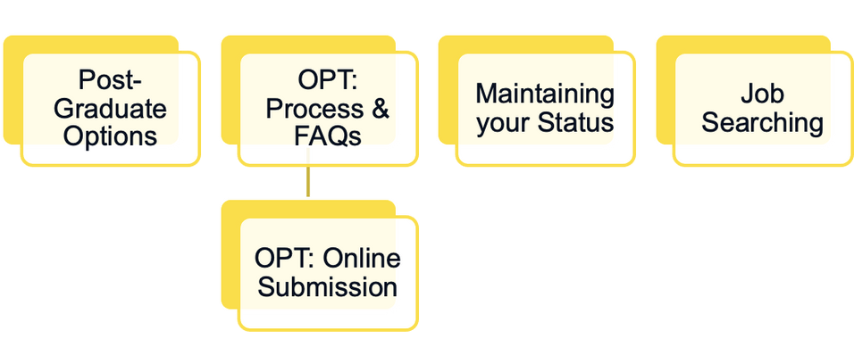


Agenda

Slide 5


You're Graduating, now what?
Return home to pursue work or an advanced degree
Transfer your academic record to a new institution to earn an advanced degree
Apply for OPT (Optional Practical Training)

Slide 6
Returning home
Must exit U.S. before or on the last day of 60-day grace period
  Job Searching at home might vary from the U.S.
but the Office of Career & Professional Development is still happy to support your search.
If you leave the U.S. prior to end of 60-day grace period, you have forfeited your status and would need a new visa status to return (includes Canada & Mexico)
  If you have applied for OPT, you must be in the US
to process your EAD - do not leave the country
until you have received your EAD card.

Slide 7
Transferring to another school
  If not doing OPT, transfers must be within 60 day grace period after program ending to maintain an Active status in SEVIS
  If on OPT, transfer will automatically end your OPT authorization.
  Must provide acceptance letter from new school to release SEVIS record
  From time of record transfer, you will have 5 months, or at next available term start, to begin your new program (whichever is sooner)

Slide 8
OPT (Optional Practical training)
What is OPT (Optional Practical Training)?
  OPT is an employment benefit granted by the U.S. Citizenship and Immigration Service (USCIS) for eligible F-1 students.
  OPT MUST be related your MAJOR field of study (i.e., if you majored in Biology and minored in Computer Science, you are only eligible to work in the field of biology.
  Initial OPT is for 12 full months.
  If you majored in a STEM field, there is an additional 24 month extension (separate application)

Slide 9
OPT Eligibility
  Must have been in lawful F-1 student status for the two semesters immediately prior to your OPT start.
  You must be in your last semester to apply (eligible to apply within 90 days of graduation date).
  You must actually “be in the U.S.” to apply.
  You do not need to have a job offer to apply.
  You must complete all graduation requirements before the program end date indicated on I-20 (closely monitor this date).
  You must NOT have completed 12 months or more of full-time CPT (curricular practical training).
  OPT cannot be used for the same education level twice.

Slide 10
OPT Application checklist
Step 1: Read about the F-1 Optional Practical Training (OPT ) process on Study in the States
Step 2: Gather all necessary documents and complete Application for Employment Authorization, USCIS form I-765
Step 3: Make appointment with the OISS to review completed application form (I-765) & be issued an OPT authorized I-20. Choose your start date.
Step 4: Within 30 days of OPT authorization, file Form I-765, and await EAD (employment authorization document).
Update employer information in SEVIS within 10 days of start.

Slide 11


What to expect from your DSO meeting:
Review application and all documents for completion and SEVIS accuracy
Receive a signed I-20 with OPT authorization
This will provide you the green light to
submit your application online
Job Search support/referrals
Office of Career & Professional Development
Referrals to helpful websites:
My Visa Jobs
LinkedIn

Slide 12
Required materials for OPT application
Filing Form I-765 online– Application for Employment Authorization
U.S. passport-style photo
Copy of Most Recent I-94 and Arrival/Departure Record Copy of passport ID page (must be valid for at least 6 months)
Copy of F-1 visa in passport
Copies of all previous I-20’s, esp. those for CPT authorizations
Payment of $470 (subject to change)

Slide 13
How to choose your OPT start date
Your OPT start date must be within your 60-day grace period after the program completion date.
It is the date that your 12 months of work authorization begins (i.e. a July 2, 2024 start date would have a July 1, 2025 end date.)
Estimate when you would like to be available to work and choose that start date.
The OPT application can take a few months to process
A typical hiring process will also take a few months
and start dates for work can be negotiable
This date is needed to issue your I-20. Most students choose one on a Monday in the middle of the grace period.

Slide 14
Submitting your application
Once OISS issues your I-20, you have 30 days to file your Form I-765.
Filing can be done by mail or online. Visit USCIS for mailing options.

Slide 15
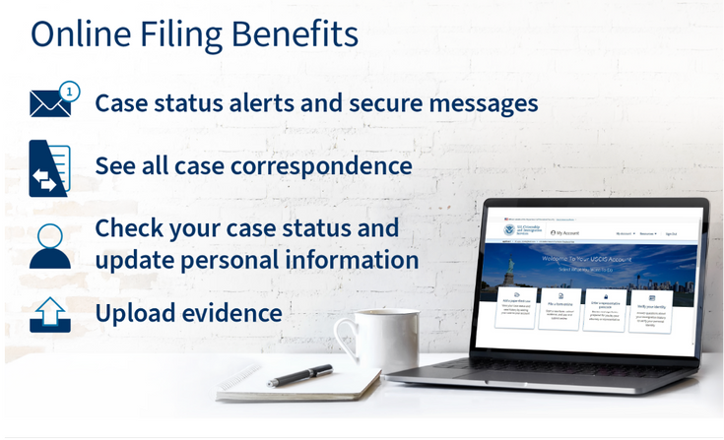
Submitting the Form I-765 online
Required documents are the same for filing by mail and online
Create PDFs or JPEGs for everything that you upload Visit: https://www.uscis.gov/i-765

Slide 16
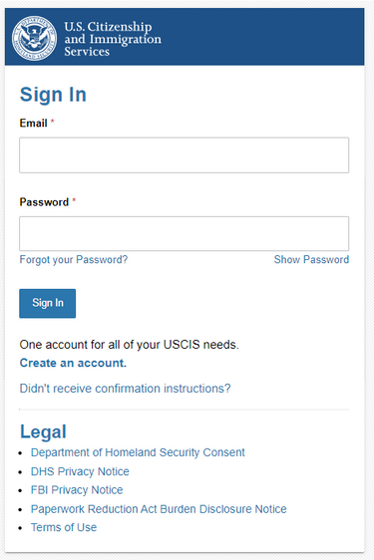
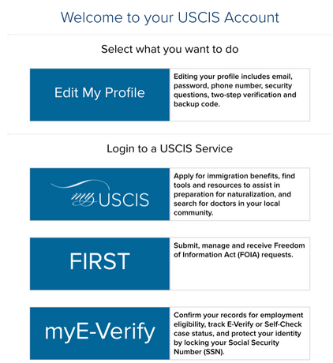

I-765: Create your USCIS account
Go through the steps
Dual verification with email code (takes up to 10 minutes)

Slide 17
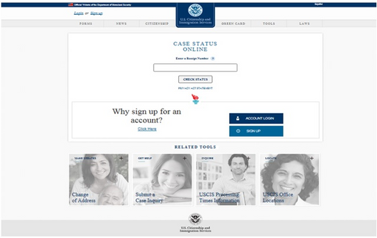
What happens after you submit?
USCIS emails you a receipt notice with your individual receipt number. You will also get it mailed
Receipt Number
The case number for the OPT application at USCIS. Check
the status of the case on the USCIS web site at
https://egov.uscis.gov/casestatus/landing.do
USCIS emails/mails approval notice and mails Employment Authorization Document (EAD) (3 weeks-5 months)
DO NOT work without your EAD

Slide 18
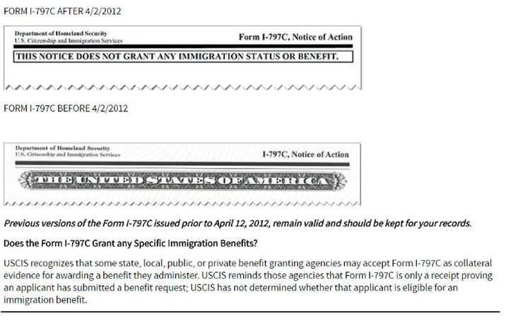
Receipt of Form I-797c
You should receive the notice by mail within 2-4 weeks after mailing the OPT application to USCIS.
The I-797C is necessary if you want to:
inquire about the status of your OPT application.
travel outside the U.S. while your OPT is pending.
Receiving the I-797C does NOT grant you work authorization.

Slide 19
Top Reasons for denial
  Payment Issues:
  Check or Credit Card payment: Money is not in account at time of processing
  Incorrect fee amount
  Check or money order form not completed properly
  Wrong dates on check, money order (U.S Date style = MONTH/DAY/YEAR = MM/DD/YYYY)
  Application received too late: USCIS must receive application no later than 30 days after OPT recommendation
  I-765 problems: Incomplete or incorrect fields
  Application not signed: sign your FULL NAME (first and last)
NOTE: if your application is denied please contact OISS immediately

Slide 20
Status once OPT is pending
You are permitted to remain in the U.S. until OPT start date
It is not recommended that you leave the
country until you receive your EAD card
No employment, either on-campus or off-campus is permitted between program completion and the start date of OPT)

Slide 21

Status during OPT
OPT is an extension of F-1 status, not a different status.
You are responsible to:
  Maintain an active SEVIS record with U of R.
  Update OISS with any changes
  Maintain an active and valid travel endorsement
  Have a valid F-1 visa to reenter the U.S.
Maintaining status of OPT:
  Must be engaged in paid or unpaid work at least 20 hours per week or full-time (40 hrs/wk)
  Can only work in your major field of study
  Cannot exceed your 90 days of unemployment

Slide 22
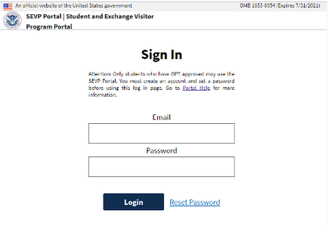
SEVP Portal
While on OPT, you MUST report all employment and address changes within 10 days of change.
You will receive email from SEVP when OPT begins.
Report any changes to:
  Residential address
  Phone number
  Employment start/end dates
  Supervisor changes
  Add second employer

Slide 23
SEVP Portal
There are four basic steps for creating an account in the SEVP Portal:
  SEVIS notifies the SEVP Portal of U.S. Citizenship and Immigration Services’ (USCIS) approval of the student’s OPT or practical training and the OPT authorization is active; the portal emails the student instructions for creating a portal account.
  Student receives the email which contains a link they must use to create the account. This link is unique to the student and cannot be shared or reused.
  Student clicks the link in the email, enters their SEVIS ID and creates a password.
  The SEVP Portal creates the student’s user profile.
https://studyinthestates.dhs.gov/create-an-sevp-portal-account

Slide 24
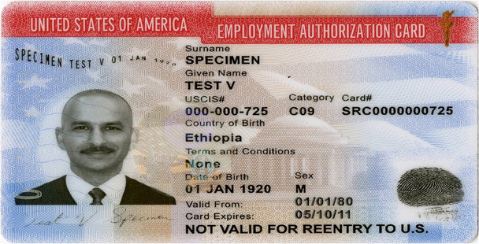

EAD card
Review your EAD card to make sure the information is accurate. If it is not, contact OISS
Present your EAD to employers as proof that you are legally authorizated to work in the US.
You will need this for hiring paperwork, such as the I-9
The EAD is a required document for entry to the U.S. during OPT

Slide 25
Job Searching
You do not need a job offer to apply to OPT
It is your responsibility to find appropriate employment. You will need to be able to make the case for how it is directly related to your program of study (major).
It may also take months to be secure a job offer - start your search early and look often
When confronted with the question, "Are you authorized to work in the U.S.?", on job applications:
select 'YES' - that is what your EAD card proves.
Network with U of R alumni
International alumni can help share their job search tips
All alumni still working in the U.S. can help guide your search

Slide 26
Types of acceptable employment
Paid employment - at least 20 hrs/wk
Multiple employers or short-term employers - performing artists
Work for hire – contract work (1099 employment)
Self-employed business owner - full-time only Employment through an agency
Unpaid employment – volunteer or unpaid internship (not violating any labor laws)
Detailed recordkeeping by student required

Slide 27
Accumulating Unemployment
  You may not accumulate more than 90 days of unemployment. If you reach 90 days of unemployment, you need to leave the U.S. or you will be in violation of your visa
  Unemployment “adds up” whether you are in the U.S. or not
  Keep track of your unemployment.
  Once you find an opportunity, or have switched to a new opportunity, the unemployment calendar stops.
  Maintain communication with OISS.
  Update your SEVP portal as necessary.

Slide 28
Extending OPT
  You have a 60-day grace period following the end of OPT during which time your can transfer your to another level of education, or file an Extension or USCIS Change of Status
  If you intend to apply for an OPT STEM Extension, you must do so before the expiration of your 12 month OPT (can apply 90 days prior to OPT ending)
  Follow the guide for online submission.
  The only additional extension of OPT available is the OPT Cap Gap Extension, for students who have an accepted cap-subject H1-B application.
  If you receive an Extension of your OPT, the grace period will begin after the end of the Extension period.

Slide 29
Completing OPT
If you do not extend your OPT, and your EAD expires, you have the following options before the end of the 60 days grace period:
  Exit the US within 60 days
  Continue your F-1 Status and studies - Transfer your I-20 to continue studies at another school OR request a Change of Educational Level to begin new studies at UoR.
  Work with immigration legal counsel regarding a Change of Status application to a new visa category. You will need to check with your legal counsel regarding your allowed period of stay or required exit date if you have a pending change of status when your grace period ends.

Slide 30
What questions do you have?

Slide 31

Let's keep in touch
oiss@redlands.edu OISS Website
OCPD Resources

